Slide 1
Introduction
Chul Min Yeum
Assistant Professor
Civil and Environmental Engineering
University of Waterloo, Canada
AE121: Computational Method
Last updated: 2019-05-02

Slide 2

What is MATLAB?
MATLAB is a high-level technical computing language and interactive environment for algorithm development, data visualization, data analysis, and numeric computation.

Slide 3
Why Do We Learn MATLAB or Computer Programming?
Why do we use a calculator?
Why do we use MS Excel?
Why do we use Maple or Wolfram|Alpha?
Why do we use Origin?
Why do we use MS PowerPoint?

Slide 4
Introduction to MATLAB
Very powerful software package
Many mathematical and graphical applications
Has programming constructs
Also has many built-in functions
Can use interactively in the Command Window, or write your own programs
Easy to debug your program
In the Command Window the >> is the prompt
At the prompt, enter a command or expression
MATLAB will respond with a result

Slide 5
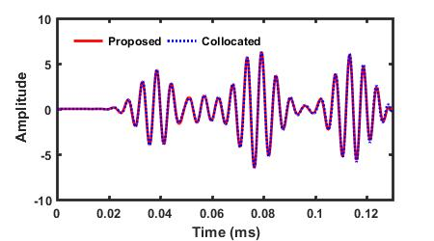
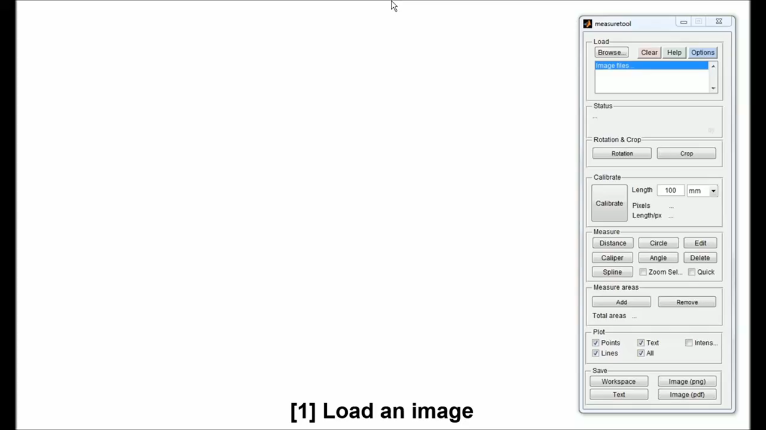
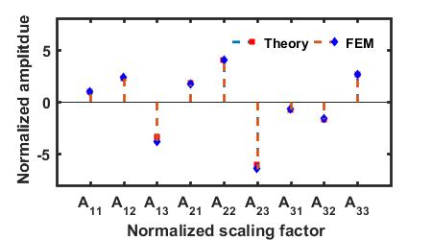
How Have I Used MATLAB?
Draw graphs
Graphic user interface

Slide 6
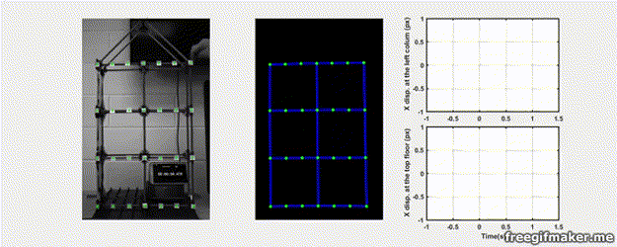
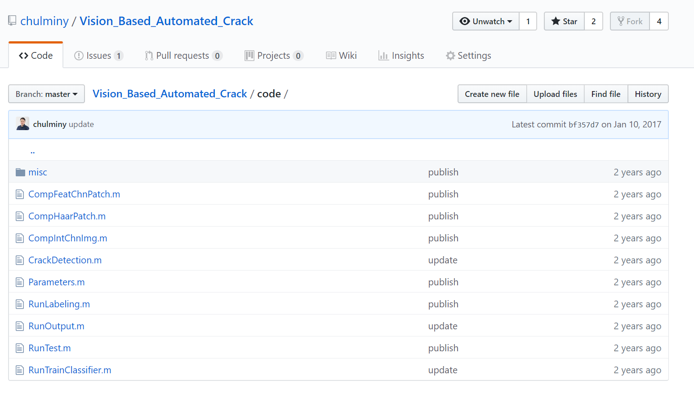
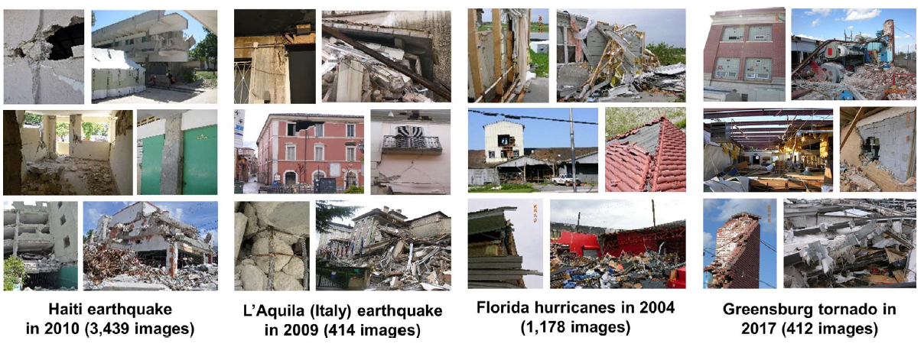
How Have I Used MATLAB? (Continue)
Making videos
Program for research
Data management

Slide 7
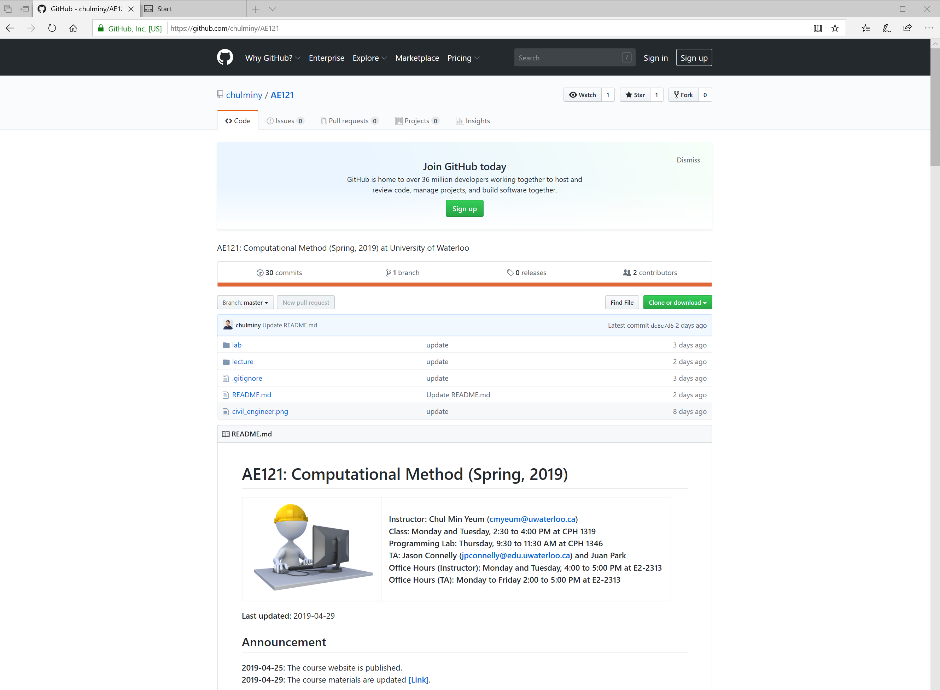
Course Website
https://github.com/chulminy/AE121

Slide 8
Course Description
This course offers a practical introduction to computer programming for engineering students using MATLAB. MATLAB is an easy and readable programming language and is an excellent choice for those learning programming for the first time. This course will cover various topics including programming fundamentals, matrix operations, file I/O, numerical methods, and data visualization. Students who successfully complete this course will gain a fundamental understanding of computer programming techniques and be able to operate, analyze, and visualize all types of data.

Slide 9
Course Description (Continue)
This course incorporates two new learning tools in MATLAB to enhance programming-learning environment: Live Editor and MATLAB Grader. The Live Editor is a scripting platform to create, edit and run MATLAB scripts as well as add formatted text, images, and equations so that students can learn programing in more informative and interactive ways. A tutorial for each topic is provided in the Live Editor format. The programming lab and homework assignments will be designed using the MATLAB Grader. This tool allows students instant feedback on the correctness of their solutions through the pre-designed testers. Thus, students can be highly motivated and inspired to persevere with completing the assignments. You are expected to spend extra 6 hours (and more…) a week studying class materials as well as working on the programming lab and homework assignments.

Slide 10
Course Description (Continue)
This course includes lectures, tutorials, programming labs, and homework assignments:
Lectures will cover the major topics, emphasizing and discussing the important points, and introduce programming examples in tutorials.
Tutorials are intended to review the lectures and prepare for programming lab and homework assignments.
Programming-labs provide an opportunity to practice writing and debugging programs with TA’s and instructor’s assistance.
Homework assignments are to provide additional practice for programming and evaluate your knowledge and programming skills

Slide 11
Course Objectives
Define your problems with programmable logic in MATLAB
Compose working, efficient, and readable code in various ways
Debug your code to identify and fix programming errors
Identify suitable keywords to search for code snippets on the web
Apply MATLAB to solve mathematical and engineering problems

Slide 12
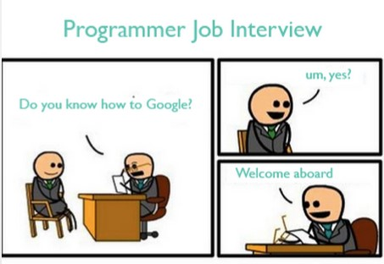
Googling
Defining your problem
Identifying keywords
Understanding the answer
Implementing them in your code
https://coursework.vschool.io/the-art-of-googling/

Slide 13
How to Improve Your Programming Skills
Step 1: Ensure your program runs without errors or warnings
Step 2: Understand a model solution provided (e.g., program logic, useful built-in functions, programming styles)
Step 3: Consider how to modify/improve your own programs
Step 4: Re-write your program from scratch without copying solutions
Extremely important!!

Slide 14
How to Complete this Course with Over 90
Review lecture slides and tutorials before attending programming labs
Submit all lab and homework assignments
Do not skim the code in tutorials and assignment solutions. Type and run all scripts in your editor to familiarize yourself with the syntax
Post at least one question on a course website every week and help/teach other students
Replicate built-in functions with your own code
Employ a MATLAB editor, workspace browser, and debugging tool actively
Vectorize your code without loop and selection statements
Use MATLAB instead of MS Excel, Wolfram|Alpha, or a calculator to complete your tasks (for long-term)

Slide 15
Prerequisite
"Linear algebra" (AE 115) and "Calculus 1 for Engineering" (MATH 116) are prerequisites for this course, which you learned in the 1A term. If you are not familiar with these topics, please review corresponding course notes or tutorials.
MATLAB (matrix laboratory)

Slide 16
Course Textbook
This course is not based on any particular textbook. However, lecture slides have been prepared using the following references:
Attaway, Stormy. "MATLAB-A Practical Introduction to Programming and Problem Solving," Elsevier, 2018.
Moore, Holly. "MATLAB for Engineers," Pearson, 2017.
Purchase a MATLAB license…

Slide 17
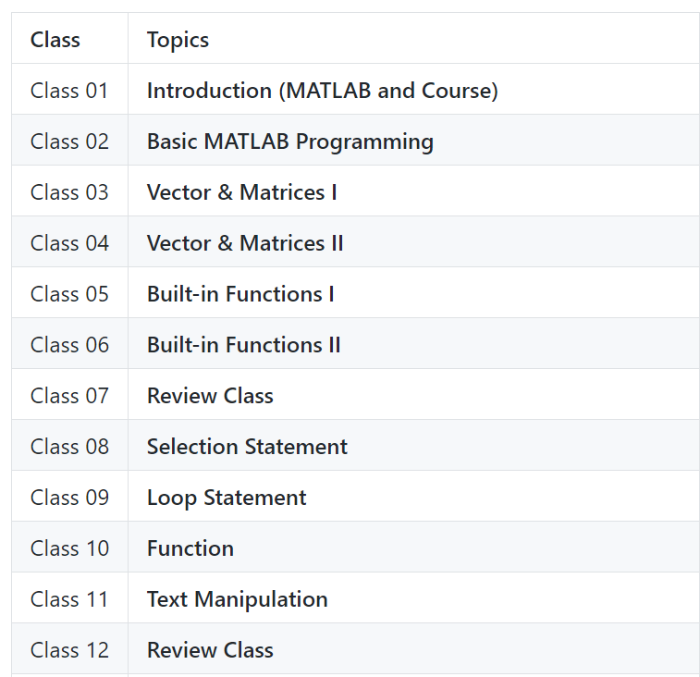
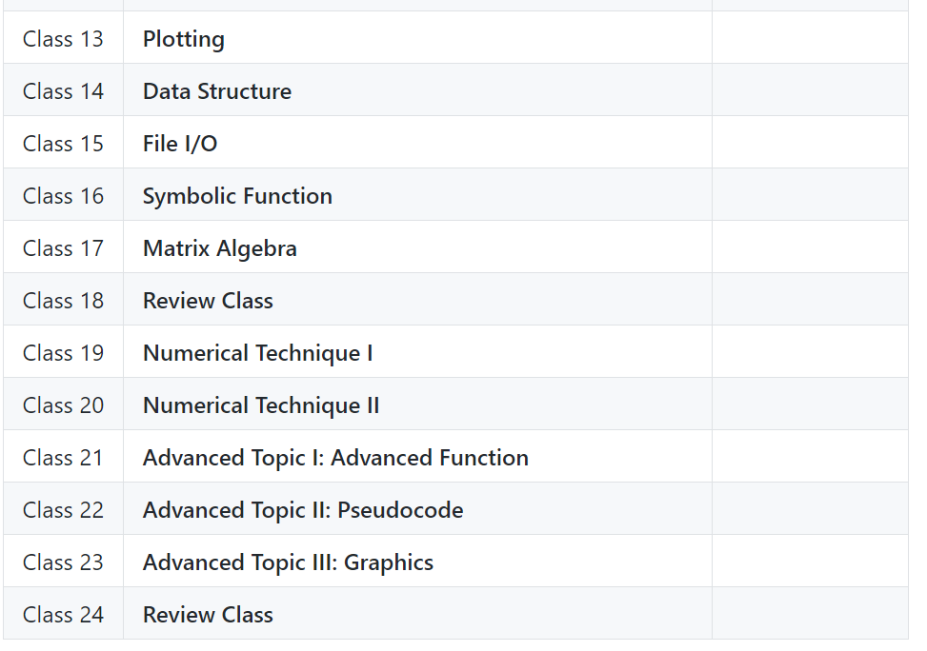
Course Outline

Slide 18
Homework Assignments
Students should be encouraged to work in groups through collaborative learning, but to submit their assignments individually. Students must not share their solutions with other students. The TA will run software to check your scripts to detect plagiarism. Please do not think that you may be able to deceive graders. Although you pass all the problems in MATLAB Grader, you will get a 0 grade if your solution is considered plagiarism and may be reported to Engineering Undergraduate Associate Dean as an academic offense. Each homework will be uploaded on Saturday night and must be submitted before the Monday class on the following week (ten days). After the due date, homework assignment online will be closed, and you are not able to submit your works. Again, no late submission is accepted, and any missed homework will be given a grade of 0. Thus, students who are not able to submit their assignment must inform the TA in advance with an email or at the office hour if you have a valid excuse.

Slide 19
Communication
All communication will be made through this course website, especially for this web page. The instructor will frequently make a note in the "Announcement" section after updating the web page. Students can configure email notification for by "watching" this course website or use a version control system for tracking its changes (The link will be provided on every announcement to track the changes). Thus, students are responsible for checking the website regularly for any relevant course information or announcements. We will post an important announcement through LEARN, but LEARN will be only used for such announcement notification. Lecture slides, homework assignments, tutorials, and solutions are only accessible through this course website.

Slide 20
Communication (Continue)
In this course, the instructor, TAs, and the students are encouraged to engage in online discussions to create and facilitate a collaborative learning experience. Students are invited to ask questions and answer them and share their knowledge and resources. Please direct your communications to the Issues board (tab) on this website. However, if there is a good reason not to use the discussion forum (e.g., personal matters, a question that might reveal your solution of your report, etc.), please directly contact the TA via email (jpconnelly@edu.uwaterloo.ca) or use the office hours.

Slide 21
Communication (Continue)
To post questions or comments, students should make their own Github account. Students do not need to make their accounts using school emails if they already have accounts or they would have anonymity.
Please be respectful of your peers, instructor, and others in your posts and comments.
Asking good questions is another way of learning by summarizing and explaining what you know and do not know. Thoughtful questions and answers will help all students in this class. Before posting a question, please ask yourself whether you are truly stuck (meaning that the answers cannot be readily found on the web) and your question are complete and legible.
In addition, please check if the same question was asked before.
Inappropriate posts and comments will be immediately deleted and closed without notice.

Slide 22
Grading
The final grade will be based on the total marks earned from two exams (midterm and final), nine programming lab assignments, and ten homework assignments. Percentages of the grade components are provided as:
Programming lab assignments (20%)
Homework assignments (20%)
Midterm exam (25%)
Final exam (35%)
Note that assignments and exams are cumulative.
You can get all marks from programming lab and homework assignments

Slide 23
Weekly Workflow
 | Monday | Tuesday | Wednesday | Thursday | Friday | Saturday | Sunday
Lecture | 14:30 – 16:00 | 14:30 – 16:00
Programming lab |  |  |  | 09:30 – 11:30
Assignment open |  |  |  |  |  | 00:00
Lab assignment due |  |  |  | 11:30
Homework assignment due | 14:30
Instructor's office hours | 16:00 – 17:00 | 16:00 – 17:00
TA’s office hours |  |  | 11:30 – 12:30 | 11:30 – 13:00 | 13:00 – 14:00
Best time for tutorial study
Best time for doing homework
Best time for posting questions

